Slide 1

New York County COVID Analysis
Chang Xu

Slide 2
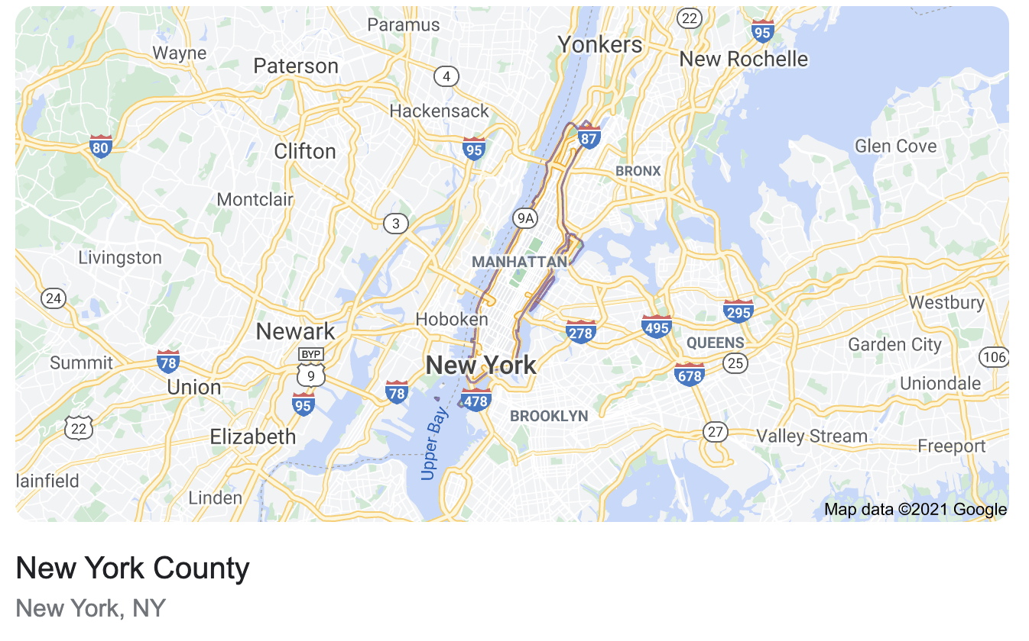
New York County Introduction
Most densely populated county in the United States, more dense than any individual American city
On business days, the influx of commuters increases the number of people to more than 3.9 million.
Manhattan has been described as the economic and cultural center of the United States and serves as home to the United Nations Headquarters.

Slide 3
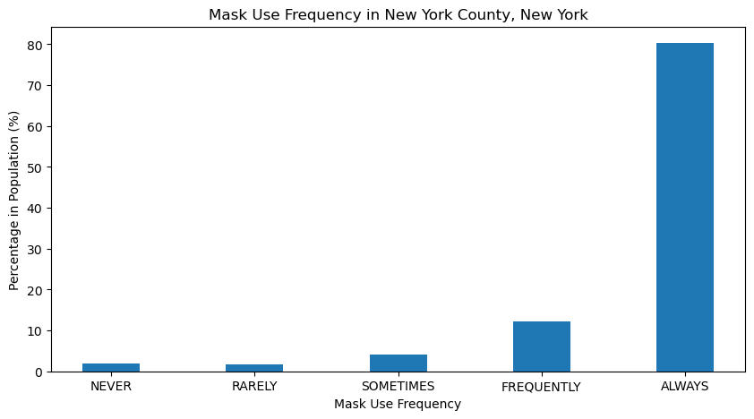
A4 Result: New York County Mask Compliance
80.3%
12.1%
2%
1.6%
4%

Slide 4
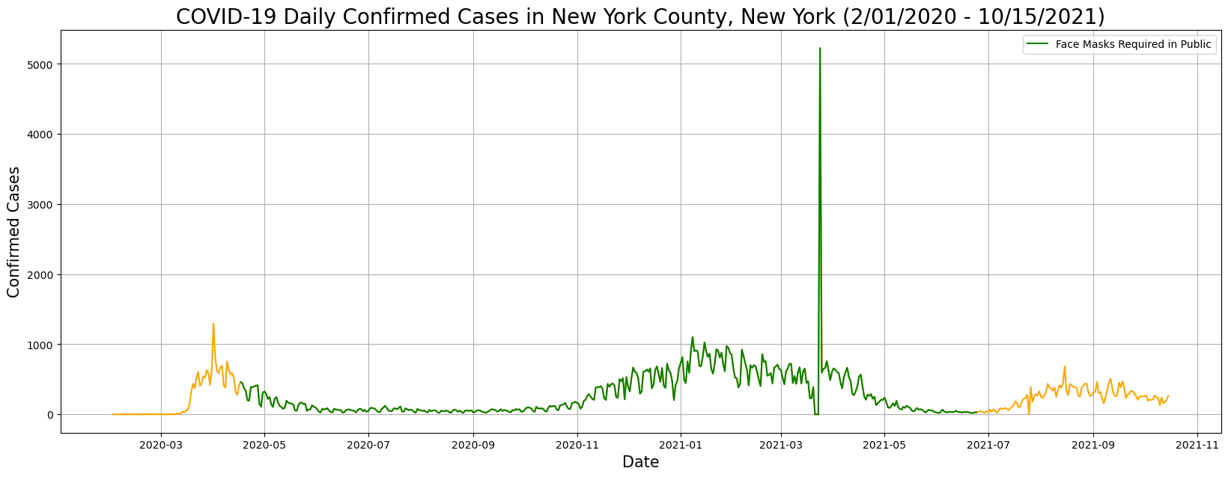
A4 Result: Daily Confirmed Cases

Slide 5
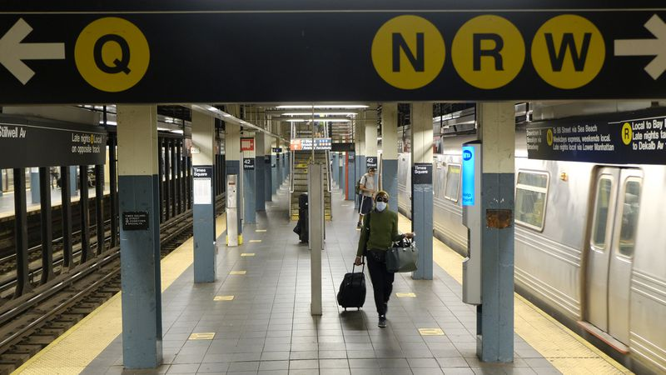
Extension Study: New York County Subway Usage
Research question
How is the frequency of people using the New York City subway system influenced by the pandemic and the county’s mask-wearing policy?
Hypothesis
People use the New York City subway system less when there are more confirmed cases and when mask-wearing is not required.

Slide 6
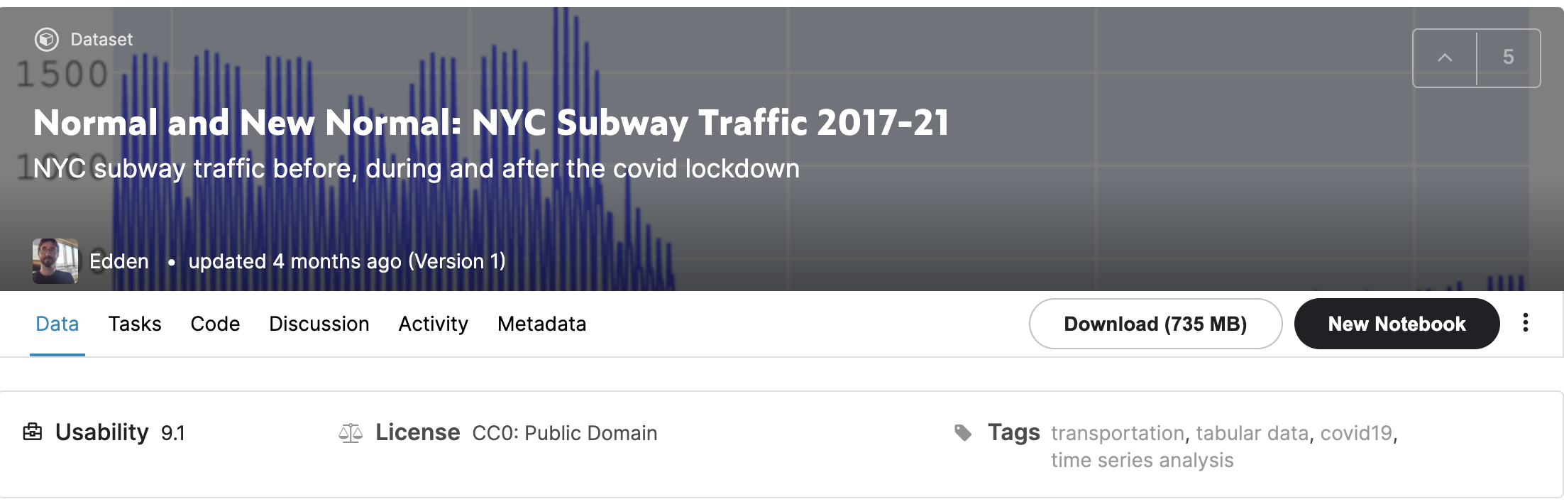
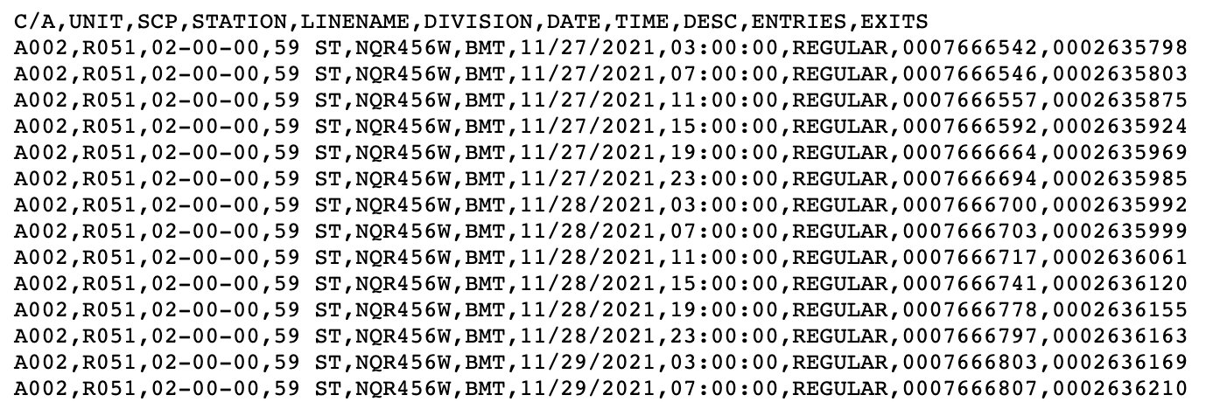
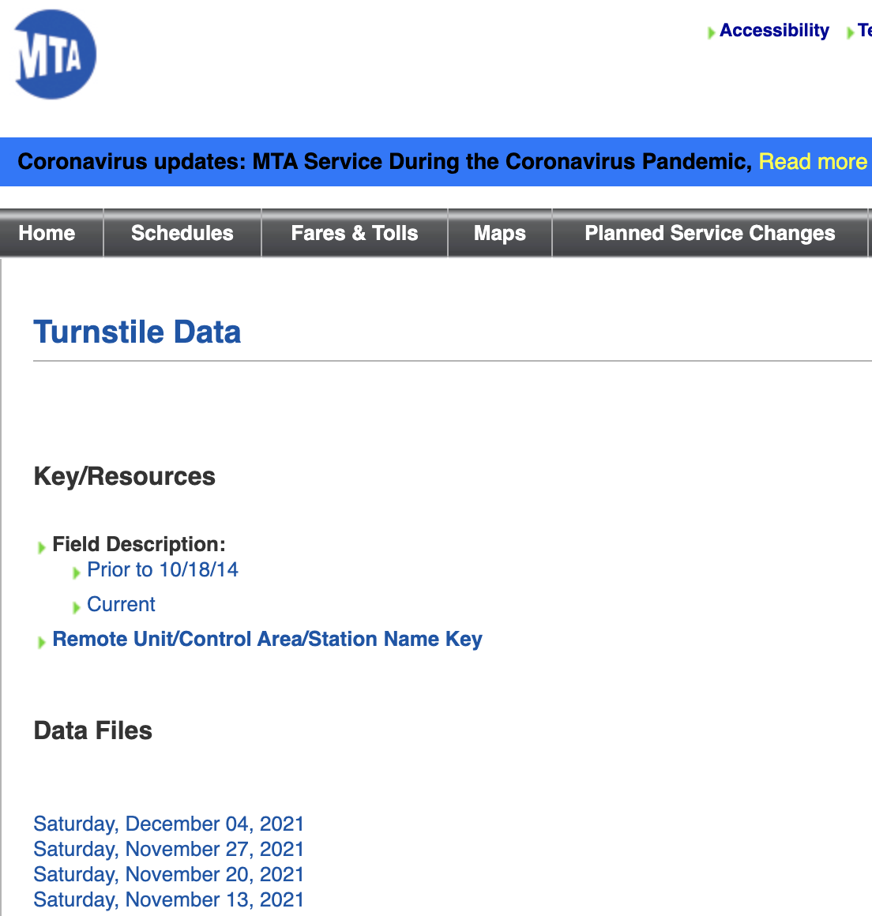
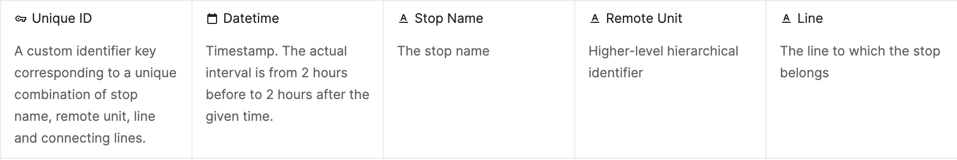
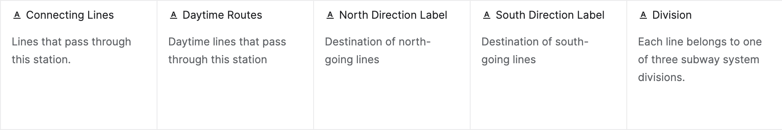
Data

Slide 7
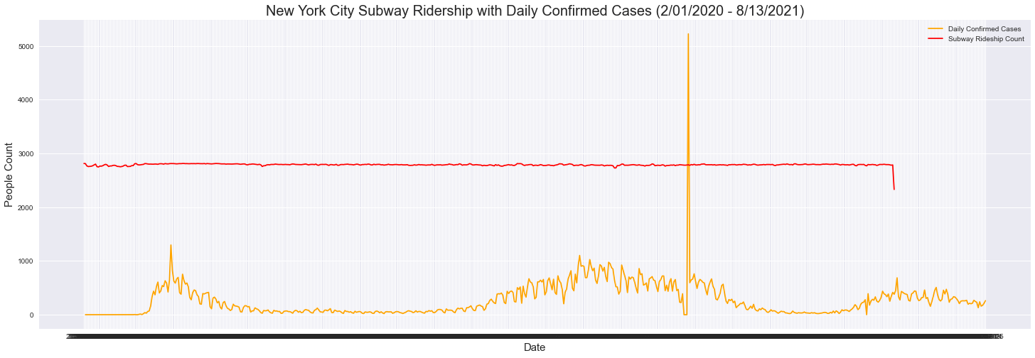
A5 Result: Subway Ridership with Daily Confirmed Cases

Slide 8
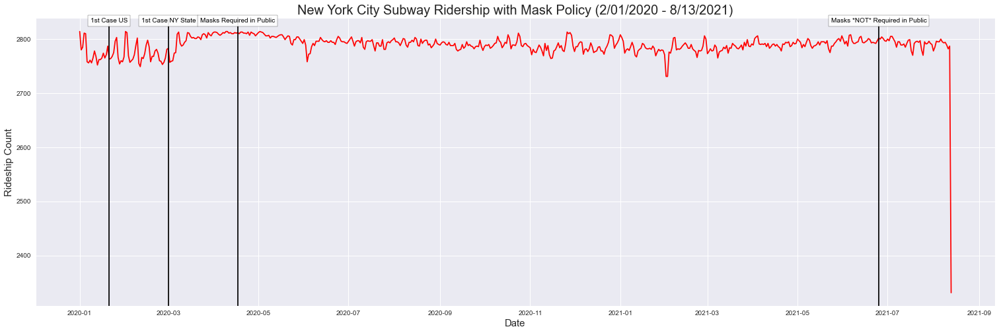
A5 Result: Subway Ridership with Mask Requirement Policy

Slide 9
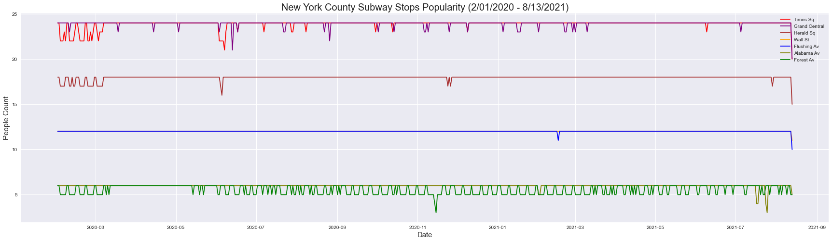
A5 Result: New York County Subway Stops Popularity

Slide 10
A5 Result: New York County Subway Stops Popularity

Slide 11
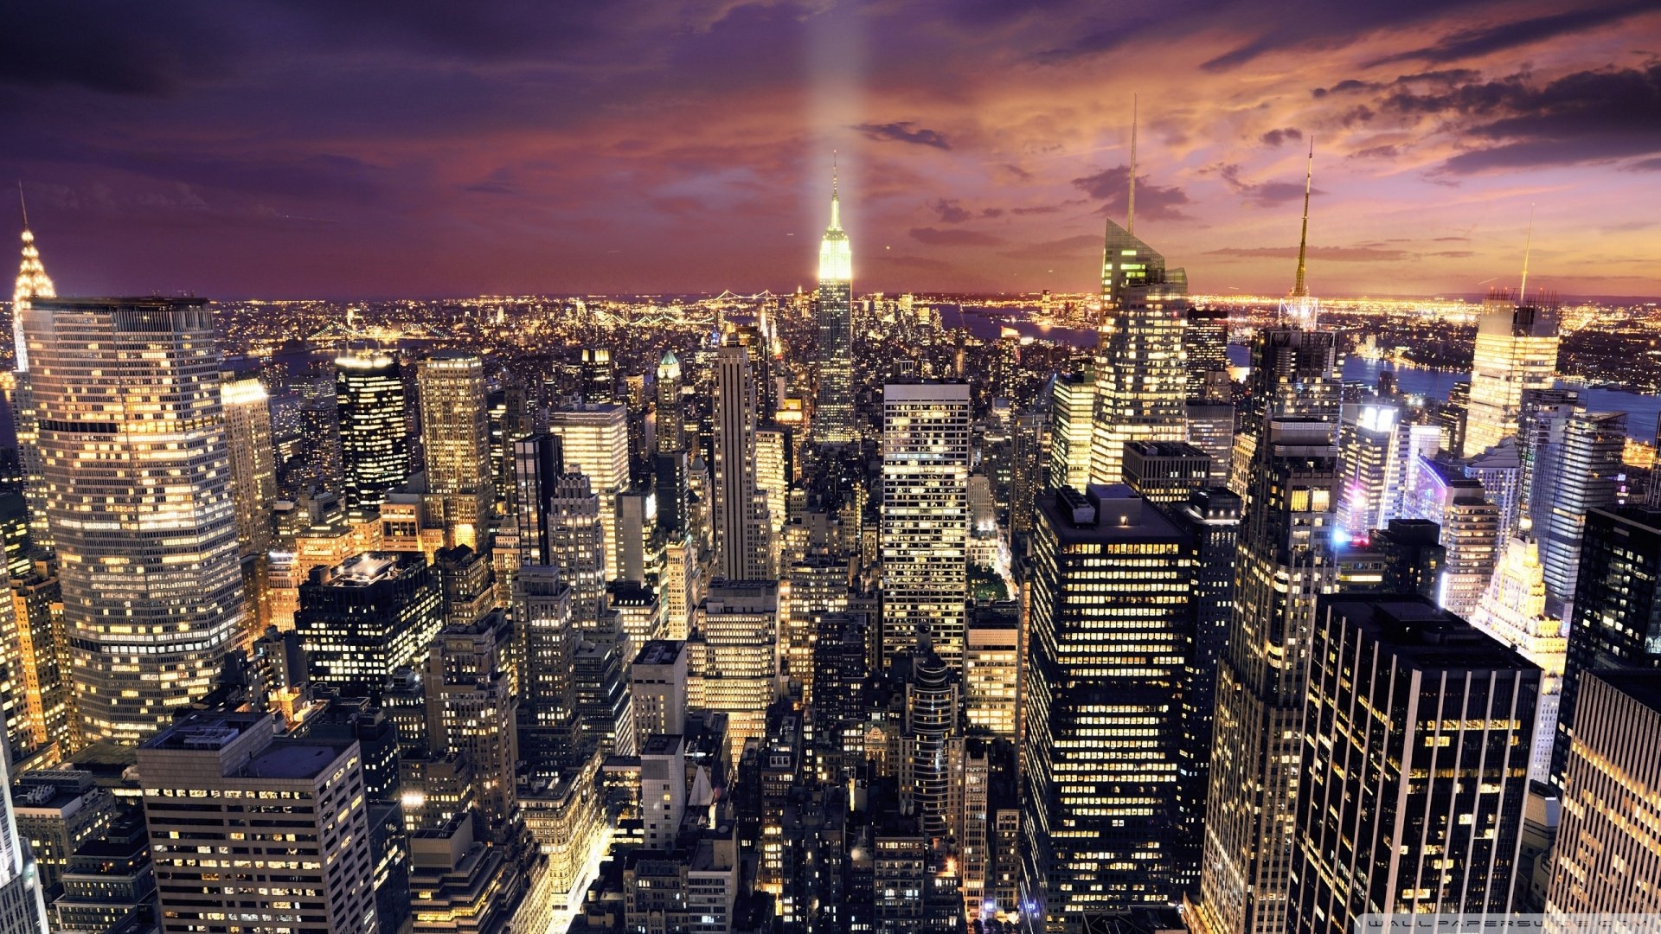
Conclusions
Wearing masks in public is effective in lowering the infection rate
New York County is still the busiest – daily confirmed cases and change of mandatory mask wearing policy have very small impact on subway ridership
Stops popularity generally stays the same. The ridership of the busiest stops and the least busiest stops fluctuate more

Slide 12
Thank you!

